Slide 1
2024 Benefits Annual Enrollment Overview
Group Presentation
October 6, 2023

Slide 2

Annual Enrollment
Nov. 8 – 22, 2023

Slide 3

2024 Premiums
  Medical premiums will not increase if you and your eligible dependents are enrolled in a Lumen medical plan and live a smoke free or tobacco free lifestyle!
  Lumen has made a significant financial commitment for your well-being. Our 2024 Healthcare costs are projected to increase 12.6 percent, which is more than $35 million annually. As a further investment in our people, Lumen will absorb nearly $25.5 million in these additional costs, rather than pass on premium increases to employees. A few benefit changes will be implemented in 2024 to offset the remainder of the costs. Each of us, and our dependents, can impact rising costs by making our health and well-being a priority. Everyone has different circumstances and needs when it comes to benefits coverage, and Lumen provides benefits to support you and your family in various life stages.
Note:
If you and/or your eligible dependents are tobacco users and not enrolled in a company sponsored tobacco cession program, you are not eligible for the 15 percent discount for nontobacco users, and you will see a slight increase in your medical premiums.
Coverage amounts, and benefit costs may increase or decrease throughout the year, in certain situations. Refer to the General Information Summary Plan Description (SPD) and the Life Insurance SPD, on the Company Intranet or the Health and Life website for more information.
2024 Premiums can be found on the US Benefits Premiums page on the Company Intranet.
3
2024 Annual Enrollment

Slide 4




2024 Changes
To make it easy for you to identify “What’s New” in each medical plan, refer to the following icons.
Consumer Driven Health Plan (CDHP)
Doctors Plan
High Deductible Health Plan (HDHP)
Surest Health Plan (Surest PPO)
Note – The CDHP, HDHP and Doctors Plan are administered by UnitedHealthcare (UHC). All plans use the same UHC provider network.
4
2024 Annual Enrollment

Slide 5

2024 Prescription Drug Changes
Essential Prescription Drug List (PDL)
  Your medication may change to a new tier with the new Essential PDL.
  You can use the pricing tool to review costs. Prices may vary depending on which plan you enroll in.
  Excluded drugs on the new Essential PDL are listed as Non-Formulary and have a pathway to coverage. If you have tried and failed on the covered alternative medications, the non-formulary drug will be covered.
Note: The Essential PDL is currently in place for the Doctors Plan; however, the copays differ from above plans.
5
2024 Annual Enrollment

Slide 6
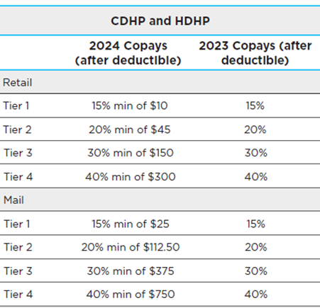
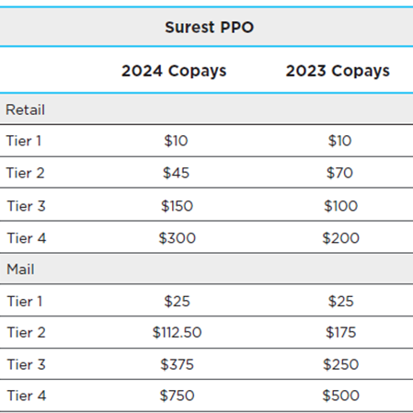
2024 Prescription Drug Changes
Copay Updates
No changes to Surest Specialty copays.
Note: No changes to the Doctors Plan copays.
6
2024 Annual Enrollment

Slide 7
2024 Prescription Drug Changes
Rx Vital Medication Program
  This program offers certain life-saving/emergency drugs at no additional cost to you.
  Covered drugs include: preferred insulins, albuterol, glucagon, epinephrine, and naloxone.
Rx Polypharmacy Value Management Program
  If you take five (5) or more different medications this voluntary program can help.
  OptumRx will work with you, your pharmacists, and prescribing physicians to identify medications that you may no longer need and fine-tune the dosage and time period for the ones you do.
Real Appeal Rx – GLP-1 Weight Loss Medication Program
  When prescribed a GLP-1 medication for weight loss without a documented diagnosis of diabetes(e.g., Wegovy, Saxenda etc.), you must join Real Appeal Rx to get the required prior authorization for this prescription coverage.
  Real Appeal Rx works in tandem with your GLP-1 weight loss medication to help you develop sustainable habits with 1:1 personal coaching, live group sessions, nutritional support, online resources and on-demand fitness classes. Questions should be directed to UnitedHealthcare at 800-842-1219.
7
2024 Annual Enrollment

Slide 8

2024 Prescription Drug Changes
Rx Specialty Coupon Management
  This program allows you to potentially save money by taking advantage of pharmaceutical manufacturer coupons.
  OptumRx will let you know if a coupon is available on your medication and how you can sign up for coupon savings each month.
Note: The Rx Specialty Coupon Management program is currently in place for the CDHP and HDHP.
8
2024 Annual Enrollment

Slide 9
2024 Medical Changes
Deductibles Will Increase
Plan | * Coverage Level | 2024 Deductible |  | 2023 Deductible
 |  | In-Network | Out-of-Network | In-Network | Out-of-Network
CDHP | Employee | $1,600 | $3,200 | $1,500 | $3,000
 | Employee + Spouse/Domestic Partner or Employee + Children | $2,400 | $4,800 | $2,250 | $4,500
 | Family | $3,200 | $6,400 | $3,000 | $6,000
HDHP | Employee | $1,600 | $3,200 | $1,500 | $3,000
 | Family | $3,200 | $6,400 | $3,000 | $6,000
Note: HDHP does not have the same coverage levels as the CDHP
9
2024 Annual Enrollment

Slide 10
2024 Medical Changes
Child and Family Behavioral Coaching and Virtual Behavioral Coaching
  Personalized coach-led programs that use the principles of cognitive behavioral therapy (CBT) presented in a series of weekly modules.
  The programs are designed to help members manage mild to moderate symptoms of stress, anxiety, and depression, and learn coping skills - at no cost.
  Enrollment in the programs varies depending on the age of dependents.
Expanded Acupuncture Coverage
  Acupuncture has been expanded to cover all medical diagnoses.
  Note: Acupuncture Coverage is currently in place for Surest PPO for all diagnoses. ired
Specialty Management Solutions (SMS) Program
  Enrollment in the Specialist Management Solutions (SMS) program is required to access benefit coverage for inpatient and outpatient hip, knee or spine surgery. If surgery is the right path for you, a registered nurse can help find a designated provider and facility. If you do not enroll in SMS the Prior Authorization will be denied and you could be responsible for the full cost.
  Replaces 2nd MD second opinion and $500 penalty although an optional second option through 2nd MD is still available.
  Also offers support for other specialty and outpatient surgical care needs like routine colonoscopy, orthopedic surgery, or other specialty care procedures.
  Note: Surest PPO participants will continue to utilize 2nd.MD, and a second opinion is requfor hip, knee, shoulder, or spine surgery. The $500 penalty applies for participants who do not seek a second opinion for the above surgeries.
10
2024 Annual Enrollment

Slide 11
2024 Medical Changes
Expanded Nutritional Counseling Visit Limits
  Visits will expand from three (3) per lifetime per condition to five (5) per year.
  This applies to covered health services for medical education services provided by a licensed or healthcare professional when education is required for a disease that requires self management and if there is a knowledge deficit regarding the disease.
  Some examples include Congestive Heart Failure, Coronary Artery Disease, Gout, Hyperlipidemia, Obstructive Airway Disease, Phenylketonuria and Renal Failure.
Virtual Physical Therapy
  Kaia will no longer be offered.
  Hinge Health will continue to be provided at no cost to you and your eligible dependents enrolled in a Lumen medical plan.
  Hinge Health provides all the tools you need to get moving again from the comfort of your home. Here are some of the ways your treatment plan could be tailored to you:
    Get a personal care team, including a physical therapist and health coach;
    Schedule personal physical therapy sessions as needed;
    Receive wearable sensors that give live feedback on your form in their app.
    Note: If you are currently using Kaia, you will receive an email from Kaia in Dec. indicating that your program will end on Dec. 31, 2023.
11
2024 Annual Enrollment

Slide 12
2024 Medical Changes
Fertility Solutions
  Fertility Solutions replaces Progyny for Surest members (which is the same program for UHC (CDHP and HDHP) members.)
  Fertility Solutions provides helpful information, emotional support and experienced guidance as you explore options for expanding your family.
  A dedicated team of experienced fertility nurses help you get information on cause of interfertility and treatment options; find doctors, clinics and facilities that meet your needs; and navigate the health care system.
  If you are currently undergoing treatment with Progyny, you may be eligible to continue with your current provider. Call 866-774-4626 for more information.
Health Reimbursement Account (HRA) rollover
  If you transition from the CDHP to Surest and have an HRA balance, your HRA funds will rollover automatically. NEW - You will not be required to submit a request for reimbursement.
Virtual Care Capabilities
  Surest Virtual Care Capabilities are expanding to include dermatology, gastroenterologist, migraine care, speech therapy, and more.
  This provides flexibility and adds additional access to specialty care.
  Virtual Care is considered in-network.
12
2024 Annual Enrollment

Slide 13

2024 Medical Changes
Health Savings Account (HSA)
HSA limits are determined by the IRS and are subject to change. The limits are increasing as follows:
Coverage Level | 2024 Limits | 2023 Limits
Employee | $4,150 | $3,850
Employee + One or more eligible dependents enrolled | $8,300 | $7,750
Limited Purpose Flexible Spending Account
  NEW - If you enroll in the HDHP with Optional HSA and also enroll in the Healthcare Flexible Spending Account (FSA) (Limited Purpose for dental and vision expenses), your FSA can be used for medical and pharmacy expenses once your deductible has been satisfied.
13
2024 Annual Enrollment

Slide 14
2024 What Else is New
Life Insurance
The Employee Basic Life, Employee Supplemental Life and Spouse/Domestic Partner Supplemental Life insurance coverage amounts currently reduce by 50% effective the first of the following month after your 70th birth date. This age reduction rule will be eliminated in 2024.
Solutions for Nursing Mothers
This program will be offered through the EAP at no cost to all employees and dependents who live in the household. Worklife advisors help expectant mothers address prenatal care, consultations on a variety of topics, referrals and more. A Nursing Mothers Kit will be provided along with ongoing communication material and phone support.
Voluntary Lifestyle Benefits - Airvet - 24/7 Virtual Pet Care
Airvet is a 24/7 veterinary telehealth company that can help with anything from urgent health questions to routine pet care.
Airvet offers visits with licensed veterinary professionals and has no deductibles, co-pays, and pet restrictions (number of pets, age, breed, etc.)
Lifestyle Reimbursement
In our continued efforts to promote employee health and well-being, The Fitness Reimbursement Policy will be renamed to Lifestyle Reimbursement. It will include additional activities that promote and support financial, mental, physical, and occupational well-being.
14
2024 Annual Enrollment

Slide 15
2024 Additional Updates
Employee Assistance Program (EAP) is now Emotional Wellbeing Solutions
All active Lumen employees and their household family members are eligible for the Employee Assistance Program (EAP) through Optum Emotional Wellbeing Solutions. You are automatically enrolled in the EAP at no cost even if you elect to waive medical coverage.
Actively employed and 65?
If you are 65 years old or older, please provide your Medicare Part A and Medicare Part B start date as well as your Medicare Number once you enroll in Medicare. If you have chosen to defer your enrollment, once you leave the company and if you are eligible for Lumen retiree benefits, please contact the Lumen Health and Life Service Center at 833-925-0487 as soon as possible. This is required information as our Medicare options (if eligible) require this information to enroll.
Company Couples
If both you and your Spouse/Domestic Partner are employed or one is inactive or a retiree of Lumen or an acquisition/subsidiary, please call the Lumen Health and Life Service Center at 833-925-0487 so your record can be updated. This ensures you receive correct benefit plans and programs information. This also applies to parents and adult children who are both employed by Lumen, or one is in an inactive status.
15
2024 Annual Enrollment

Slide 16

Get Ready – Starting November 1st
Ask ALEX to help you learn about your health and life benefit options including medical plans, Health Savings Account (HSA), Flexible Spending Accounts (FSAs), Voluntary Lifestyle Benefits and more. Keep in mind, even if you use ALEX, you must enroll through the Health and Life website.
Watch the What’s New in 2024 video and refer to other information on the Annual Enrollment home page on the Intranet.
Review/Add your personal information on the Health and Life website. You are strongly encouraged to use a personal email address as your preferred method to receive benefit communication. The company email does not guarantee privacy and does not comply with company policy. Benefit communication will not be sent to your company email address unless approved by Management and only on certain directives.
Answer the Tobacco-Free Discount, and the Working Spouse/Domestic Partner Surcharge questions each Annual Enrollment. Your answer can impact medical plan premiums and certain Voluntary Lifestyle Benefit plan premiums.
Chat with Sofia on the Health and Life website. Sofia is your personal benefits assistant and can answer questions and guide you as you enroll.
Register for MyEvive at lumen.com/myevive if you have not already done so. MyEvive is a customized benefit portal that puts control of your health, wealth and well-being at your fingertips.
November 8th – 22nd Enrollment has been simplified!
You can select either –
Option 1 which will provide step-by-step instructions to enroll, or
Option 2 “The Easy Button” which will allow you to keep the same plans/programs as last year.
16
2024 Annual Enrollment

Slide 17

17
2024 Annual Enrollment

Slide 18
2024 Rates
Active Full Time Employee Medical Contributions (Bi-Weekly)
18
2024 Annual Enrollment

Slide 19
2024 Rates
Active Full Time Employee Dental and Vision Contributions (Bi-Weekly)
19
2024 Annual Enrollment

Slide 20
2024 Rates
Post-1990 Qwest Union Retiree Pre-65 Medical Contributions (Monthly)
20
2024 Annual Enrollment

Slide 21
2024 Rates
Post-1990 Qwest Union Retiree Dental Contributions (Monthly)
22
2024 Annual Enrollment

Slide 22


2024 Rates
Post-1990 Qwest Union Retiree Post-65 Medical Annual HRA Amounts
Annual HRA Subsidy can be applied towards purchase of a Medicare Supplement Plan—Medicare eligible retirees or dependents should contact Via Benefits at 888‐825‐4252 to enroll in a Medicare Supplement Plan.
Post-1990 Qwest Union Retiree Post-65 Monthly Contributions for MAPD PPO + Dental Plan
Medicare eligible retirees or dependents can also enroll in the UnitedHealthcare MAPD PPO + Dental plan, with monthly retiree contributions below:
21
2024 Annual Enrollment

Slide 23

19
2024 Annual Enrollment

Slide 24
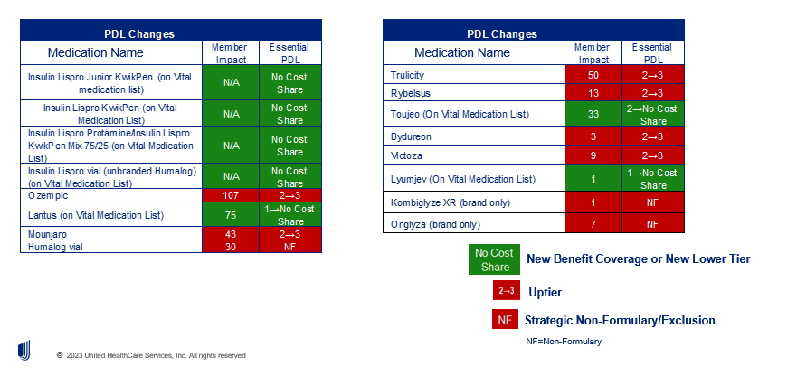
Diabetes coverage updates
19
2024 Annual Enrollment

Slide 25
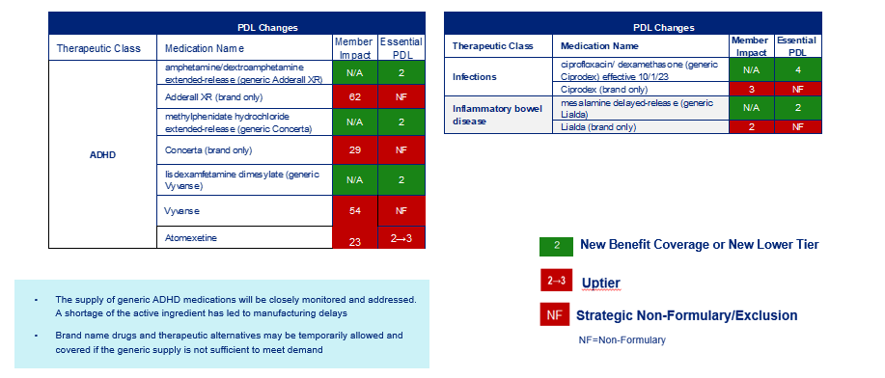
PDL updates (continued)
A new prescription is not needed as pharmacists can substitute the generic medication for the brand right at the pharmacy counter.
19
2024 Annual Enrollment

Slide 26
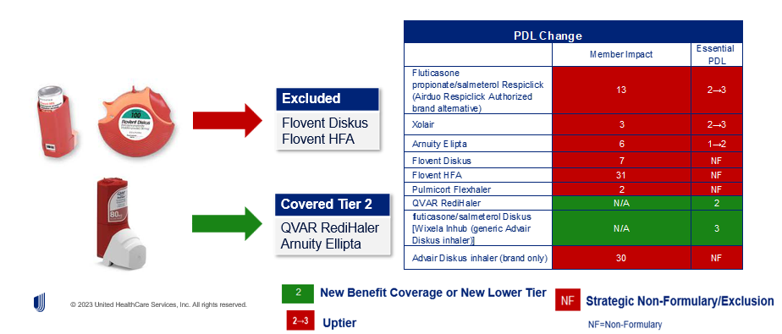
Asthma coverage updates
GlaxoSmithKline notified the FDA that Flovent HFA and Flovent Diskus will be discontinued and the last day the product will be available to order is December 31, 2023.
19
2024 Annual Enrollment

Slide 27
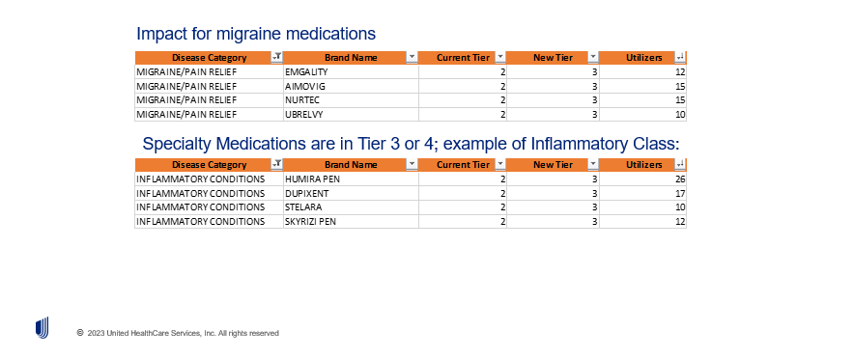
Additional Updates for Essential PDL
19
2024 Annual Enrollment

Slide 28

Appendix
19
2024 Annual Enrollment

Slide 29
2024 Rx Updates (Copay Comparison to Prior)
19
2024 Annual Enrollment

Slide 30
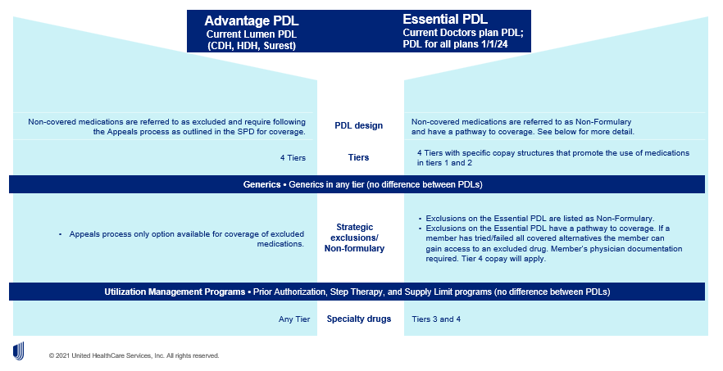
Advantage and Essential PDL comparison
19
2024 Annual Enrollment

Slide 31
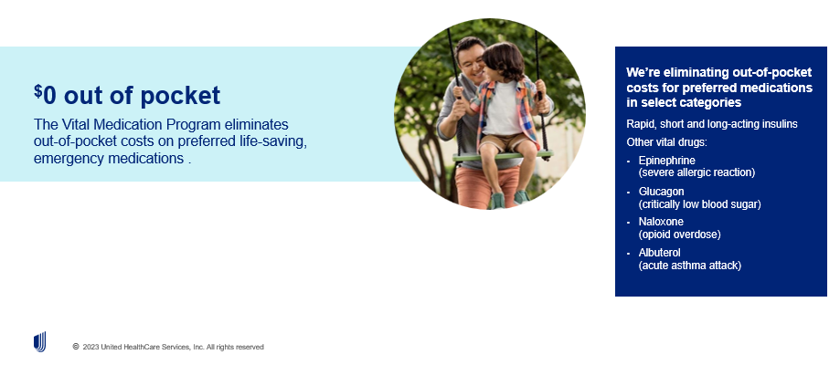
New Program: Vital Medication Program
Providing vital drugs at the right cost
19
2024 Annual Enrollment

Slide 32
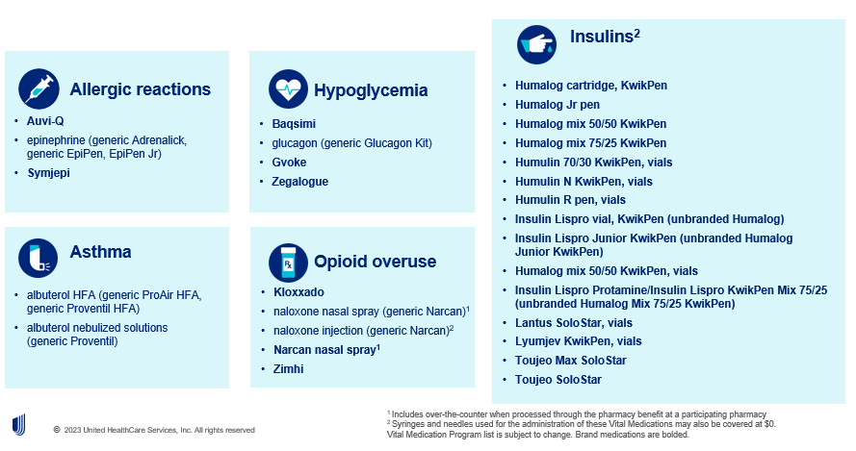
New Program: Vital Medication Program
Preferred brand and generic medications at $0 cost share
19
2024 Annual Enrollment

Slide 33
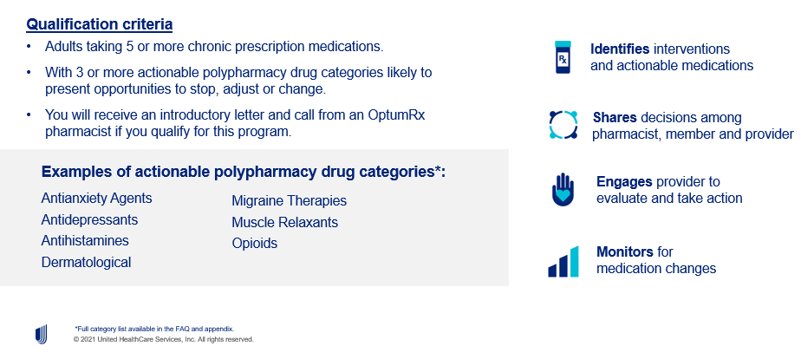
New Program: Polypharmacy
Evidence-based polypharmacy approach
19
2024 Annual Enrollment

